Slide 1
Final Projects
Lesson 21.1

Slide 2

We are almost there...
Notes:
shutterstock_304864298

Slide 3
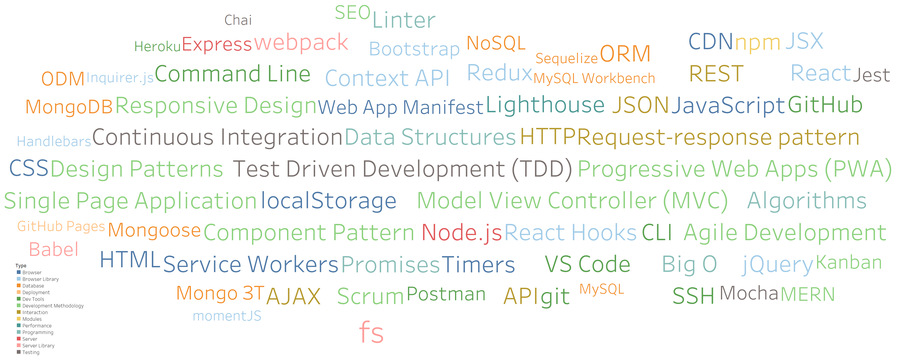
Look at all you have learned!
https://public.tableau.com/profile/spencer.shadley#!/vizhome/UWTechnologies/TechnologiesbyType

Slide 4
Your Goals Re-examined
And why do you want a new career?
To pursue a dream
To escape a dead-end job
To be able to create
To follow a fascination
To attain financial stability
To obtain financial freedom
To challenge yourself
To be a role model

Slide 5
What’s Left
Final Projects
Remaining Topics: Computer Science Algorithms, Javascript Design Patterns
Lightning Talks
Job Workshops
Demo Day!

Slide 6
Never Stop Learning!
The key to hireability and relevance is to constantly be learning.
The field is always changing and there is never a point where you can call it quits.
Stick with it! It’s a craft that you continue to hone with time.

Slide 7
Final Projects

Slide 8
Your Challenge

Slide 9


Your Challenge
You have plenty of time to work on this.
You have ALL the skills you need.
You have a team of skilled developers.
You have experts willing to help.
No excuses. Time to prove yourself.

Slide 10
Expectations

Slide 11
Expectations
We expect whatever you build to have utility.
We expect you to have market or real-world research that evidences your idea has REAL value to people.
We expect you to have done research on other web/mobile applications in your domain.
We expect you to put serious time and thought into this.
We expect you to report problems you are facing along the way.
We expect you to utilize some form of project management system.
We expect you to use agile development.
We expect you to dig deep into documentation and external resources to learn what you need.

Slide 12
Requirements

Slide 13
Coding Requirements
Uses MERN stack (MySQL is okay)
Deployed

Slide 14
Strongly Recommended
Agile Development
Linter (such as ESLint)
Unit Tests
Continuous Integration (CI) (like Travis)
Model View Controller (MVC)
RESTful architecture
UML Diagrams
Code coverage tools used (like coveralls)

Slide 15
Deliverables

Slide 16
Deliverables
Instead of homework, you will be required to submit four Project Deliverables.
Plan, Design, and Research
Ready MVP (Working App!)
Project Polish, Functionality Push, Final Plan
Mini-Presentation

Slide 17
Deliverables 1: Plan, Design, and Research

Slide 18
Deliverables 1: Plan, Design, and Research
In this plan, you will include:
An overview of the intended application and WHY you feel it’s valuable.
A set of DETAILED screen-by-screen design layouts with annotations describing all UI/UX components and all data relevant to the screen.
A breakdown of roles by group member.
A schedule for completion of various tasks.
A screenshot of your Project Management Board that shows breakdown of tasks, assigned to group members with a schedule.

Slide 19
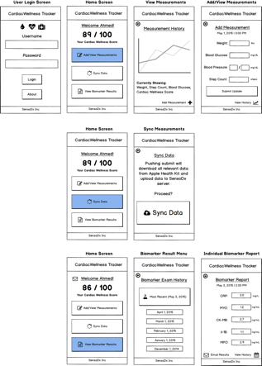
Example UI/UX Flow
Screen Map
This is intended to show you the order in which users would see screens. The three branches correlate with the three button options from the main menu.
Free wireframing tools

Slide 20
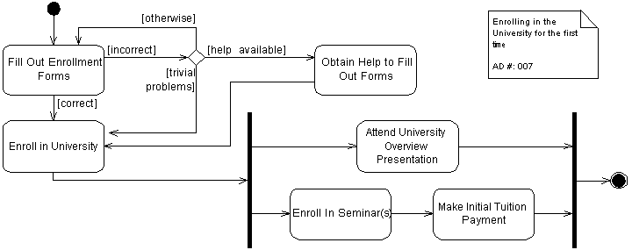
Example UML – Activity Diagram
Enrolling in a University
User Login
(Username, Password)
Add Weekly Measurement (Self-Reporting)
Sync Weekly Measurement (Sensors)
View Biomarker Results
User Health Data
Weight
Blood Pressure
Blood Glucose
Steps Walked
Deliver to Cloud

Slide 21
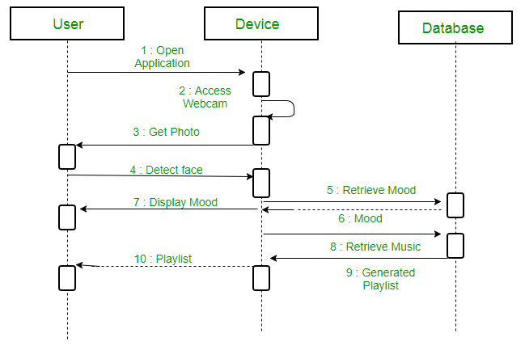
Example UML Sequence Diagram

Slide 22
Questions?

Slide 23
Look at all you have learned!
https://public.tableau.com/profile/spencer.shadley#!/vizhome/UWTechnologies/TechnologiesbyType

